Slide 1
Ectocervix, endocervix and transformation zone
Ellen Eisenberg, D.M.D.
Professor, Oral & Maxillofacial Pathology

Slide 2
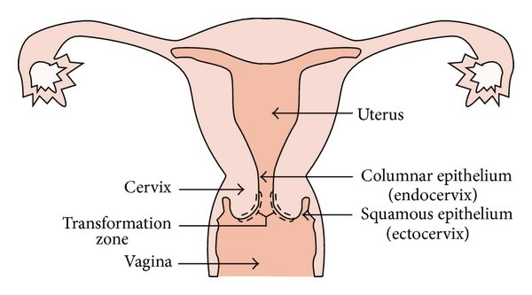

Slide 3
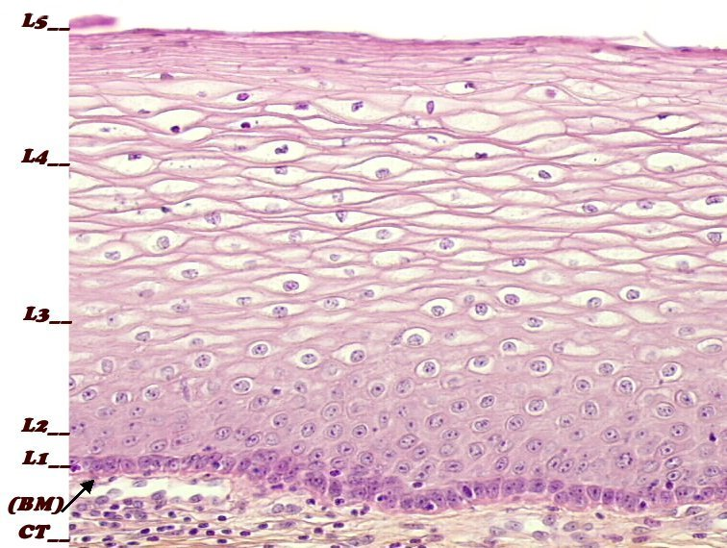
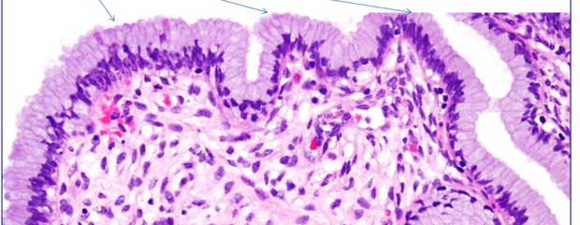
Ectocervical stratified squamous epithelium
Endocervical tall columnar and mucus-secreting epithelium

Slide 4
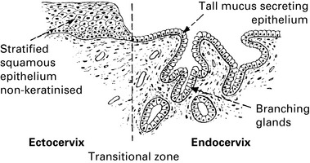
Columnar mucus-secreting (glandular) epithelium
Non-keratinized stratified squamous epithelium
Ectocervix
Endocervix
Endocervix
Transformation zone

Slide 5
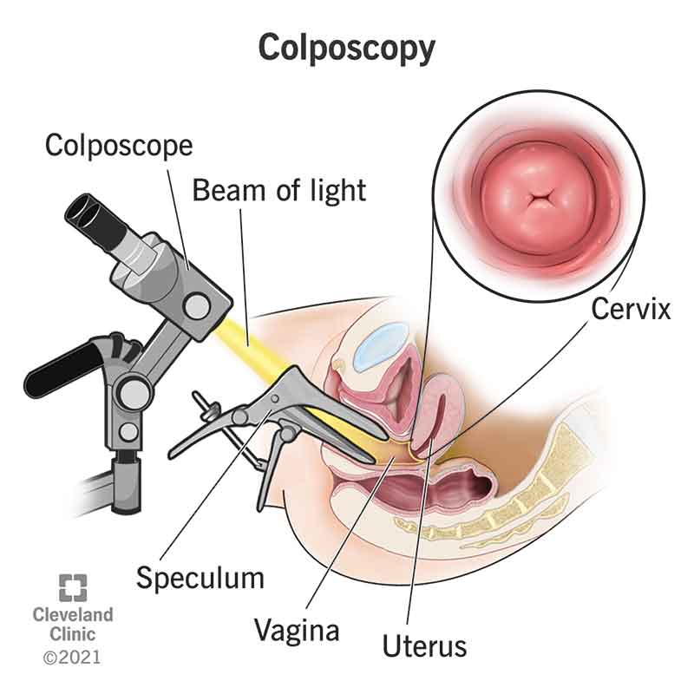

Slide 6
